Slide 1
LGBM BOOST – REGRESSION

Slide 2
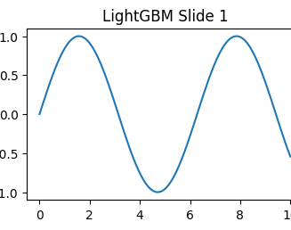
Introduction to LGBM Boost Regression
LightGBM is a boosting algorithm developed by Microsoft.
Designed for fast training and high efficiency.
Suitable for large-scale regression problems.

Slide 3
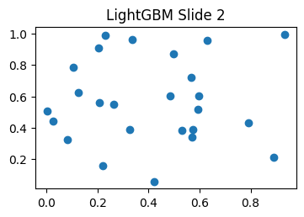
How LightGBM Regression Works
Uses leaf-wise tree growth instead of level-wise growth.
Reduces training time and memory usage.
Improves model accuracy with efficient learning.

Slide 4
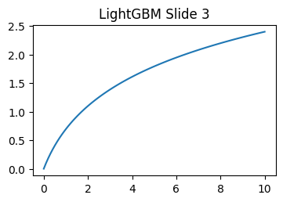
Features of LightGBM Regression
Faster than many traditional boosting algorithms.
Supports parallel and GPU learning.
Handles large datasets with better performance.

Slide 5
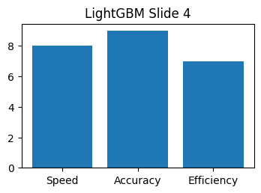
Advantages and Limitations of LightGBM
Advantages:
High speed
lower memory consumption
Limitations:
Can overfit on small datasets.
Requires proper parameter tuning for stability.

Slide 6
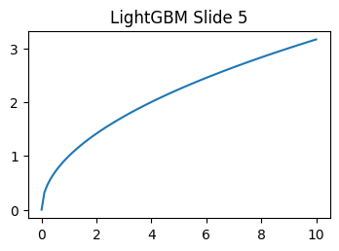
Applications of LightGBM Regression
Used in banking and financial forecasting.
Applied in recommendation and prediction systems.
Helpful in machine learning and AI projects.

